Slide 1
Eco Challenges of Transportation

Slide 2
Eco Challenges of Transportation

Slide 3
We need to act in two directions: Reducing Emissions and improving Organization

Slide 4
We need to act in two directions: Reducing Emissions and improving Organization

Slide 5
The most significant health problem arises from emissions during the "last mile" delivery

Slide 6
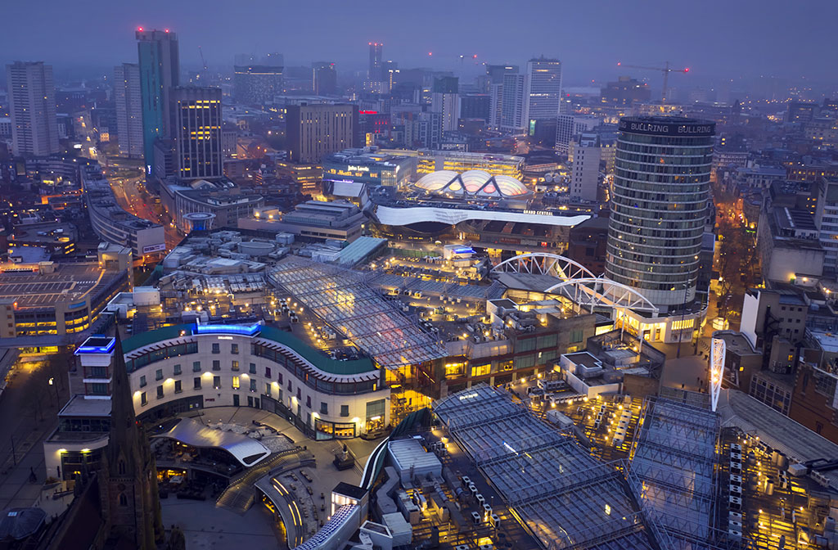
The most significant health problem arises from emissions during the "last mile" delivery

Slide 7
In Birmingham, it is claimed that 30 percent of all pollution comes from delivery services.

Slide 8
Challenges of Delivery in Traffic-Restricted Areas:
High concentration of vehicles in a small time window.
Deliveries coincide with school drop-offs and adults commuting to work.

Slide 9
Challenges of Delivery in Traffic-Restricted Areas:
High concentration of vehicles in a small time window.
Deliveries coincide with school drop-offs and adults commuting to work.

Slide 10
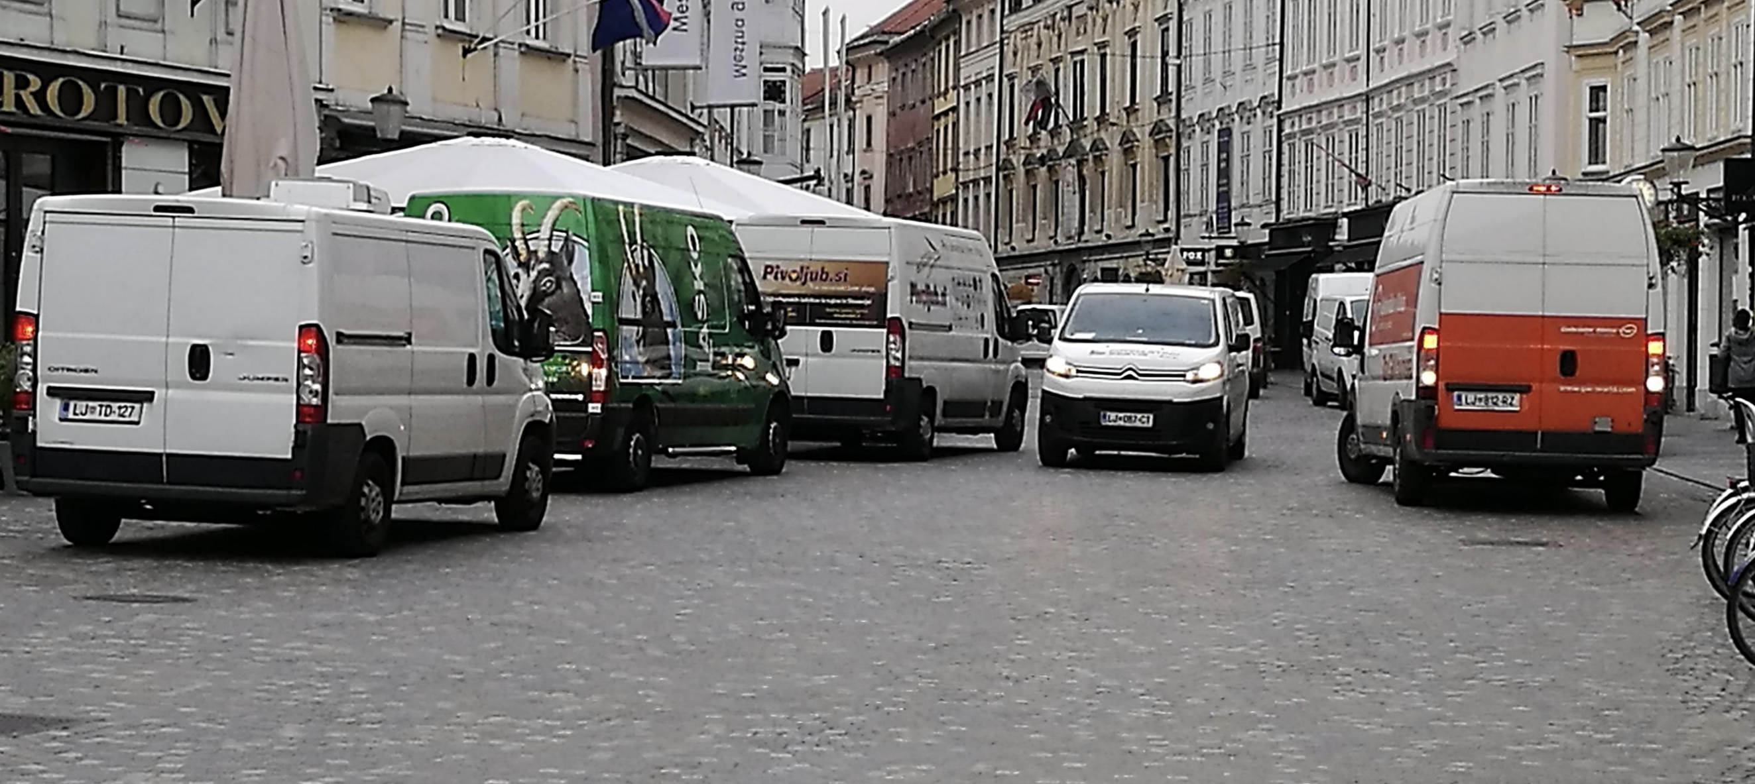
In Ljubljana, during delivery times, 90 percent of all pollution is attributed to delivery services

Slide 11
In Ljubljana, during delivery times, 90 percent of all pollution is attributed to delivery services

Slide 12
Both Ljubljana and Belgrade share a similar problem

Slide 13
Both Ljubljana and Belgrade share a similar problem

Slide 14
Both Ljubljana and Belgrade share a similar problem

Slide 15
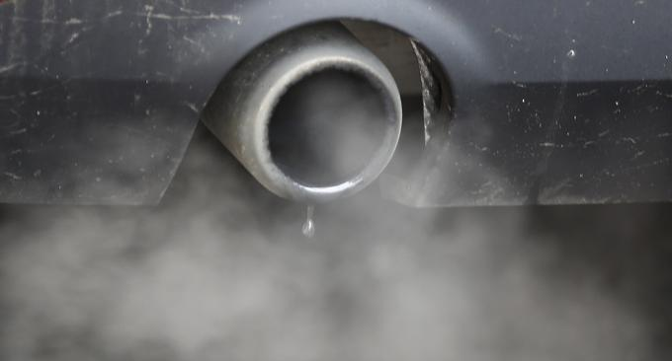
Delivery vehicles typically keep their engines running during loading and unloading

Slide 16
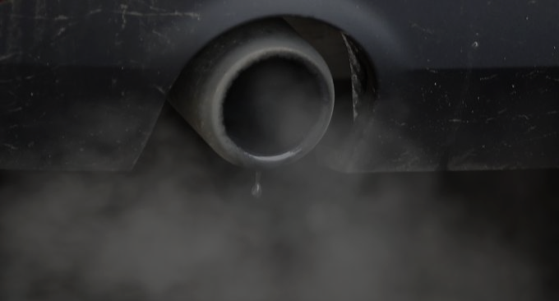
Delivery vehicles typically keep their engines running during loading and unloading

Slide 17
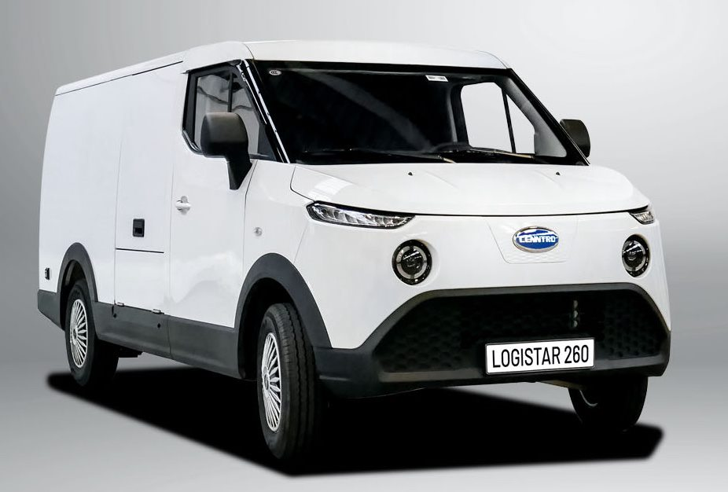
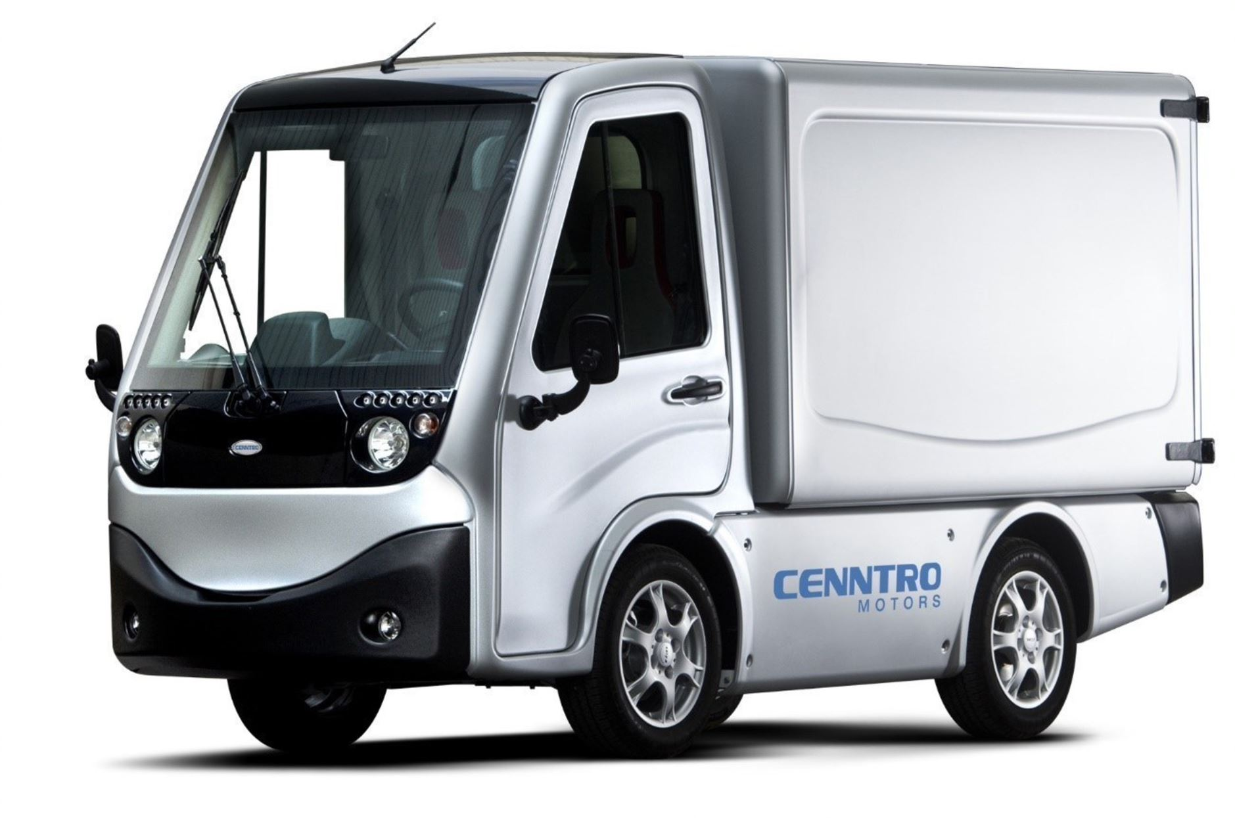
Solution:
Electric Vehicle Delivery: Shifting towards electric vehicles for deliveries. "Centralized" Delivery: Reducing the number of delivery vehicles by up to 50 percent through centralized logistics. Addressing these challenges is crucial for creating a more sustainable and environmentally friendly transportation system.

Slide 18
Solution:
Electric Vehicle Delivery: Shifting towards electric vehicles for deliveries. "Centralized" Delivery: Reducing the number of delivery vehicles by up to 50 percent through centralized logistics.

Slide 19
Solution:
Addressing these challenges is crucial for creating a more sustainable and environmentally friendly transportation system.

