Slide 1
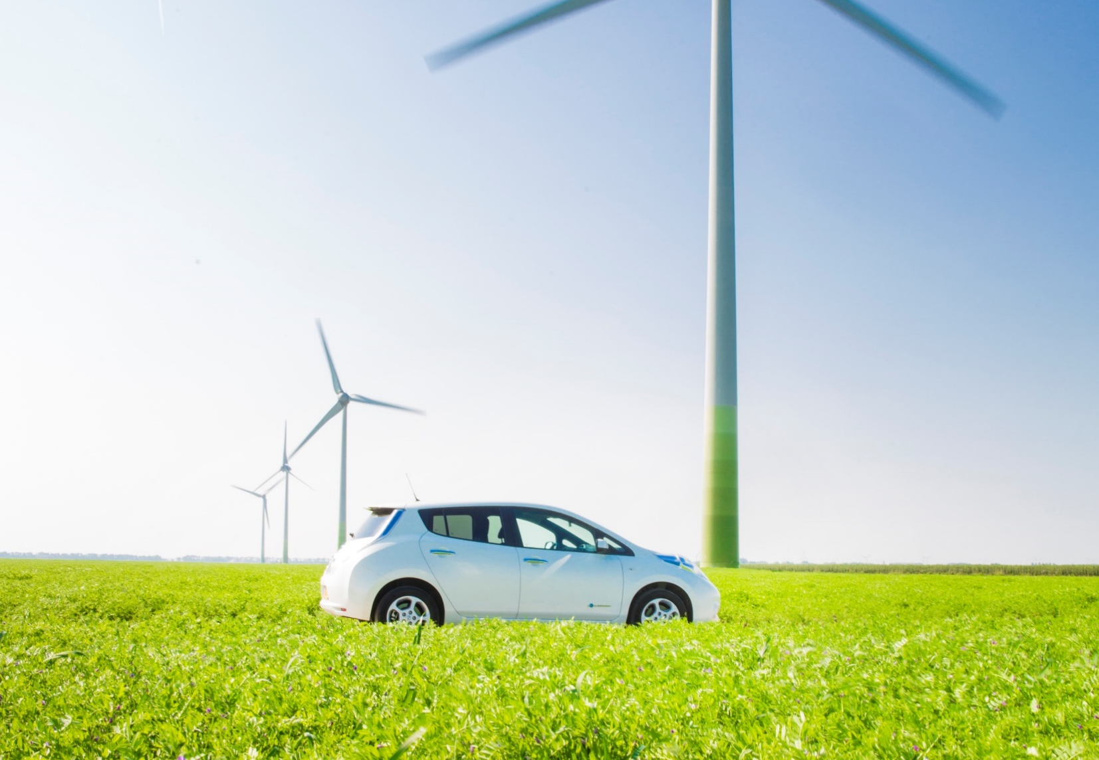




Strategies to develop EV in the Netherlands
Baerte De Brey

Slide 2
The Netherlands’ climate and energy ambitions
49% greenhouse gas emissions reductions by 2030
No more gas used in the Netherlands by 2050 – all electric society
Fully circular economy by 2050

Slide 3
2030 perspectives for Transport
All new passenger cars zero emission
All public transportation zero emission
City distribution zero emission in G40
(40 largest cities in the Netherlands)
(public private e-mobility platform)
Notes:
Ik heb het hier beperkt tot zero emissie zaken, geen biobrandstoffen genoemd.
Het is goed om te weten dat er ook een onderzoek loopt naar ZEV binnenvaart (inland shipping) maar daar is nog geen vaststaand beleid of afspraken over.

Slide 4
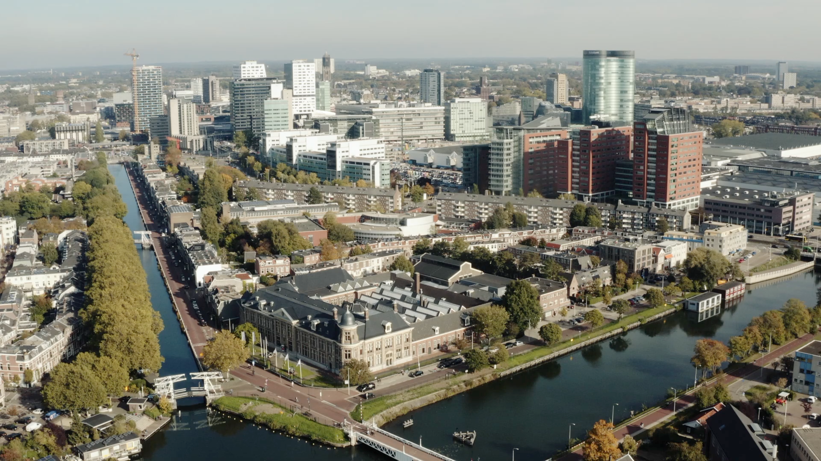
City of Utrecht: 70.000 new houses

Slide 5
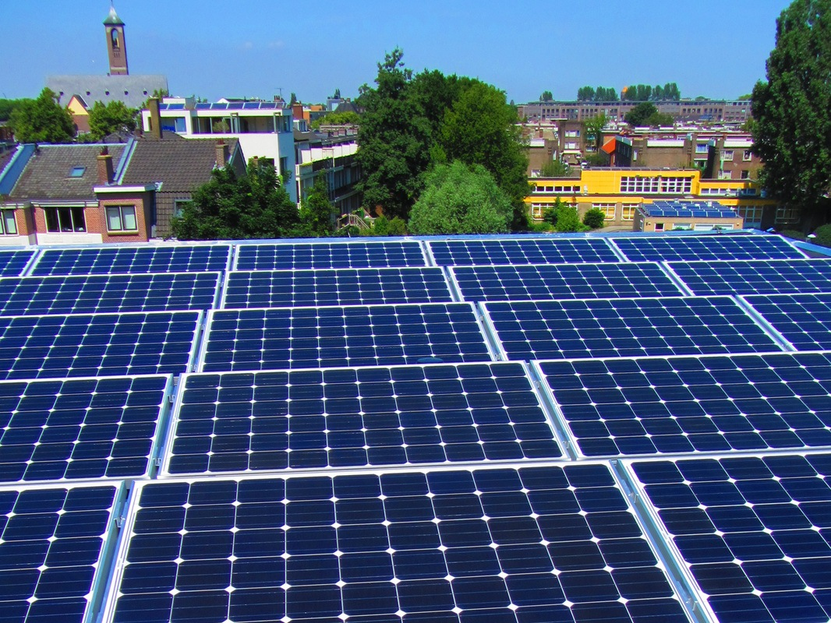

Slide 7
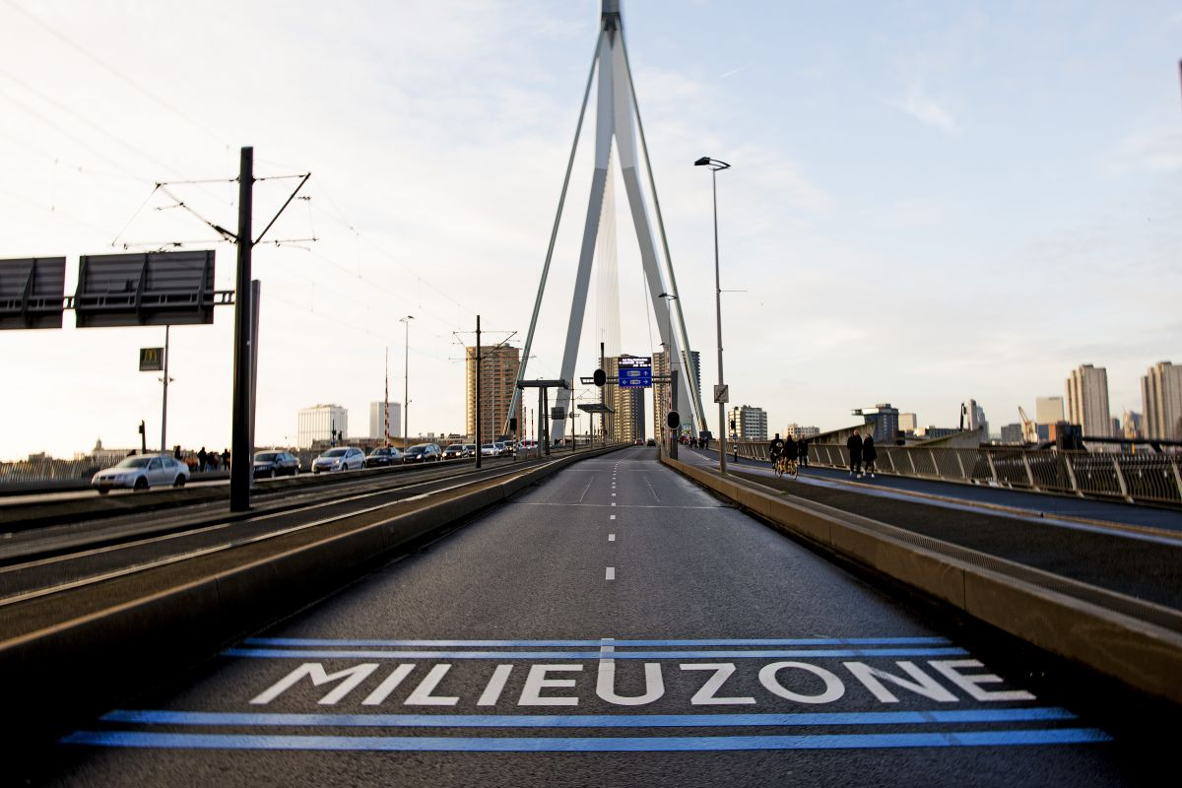

Slide 8
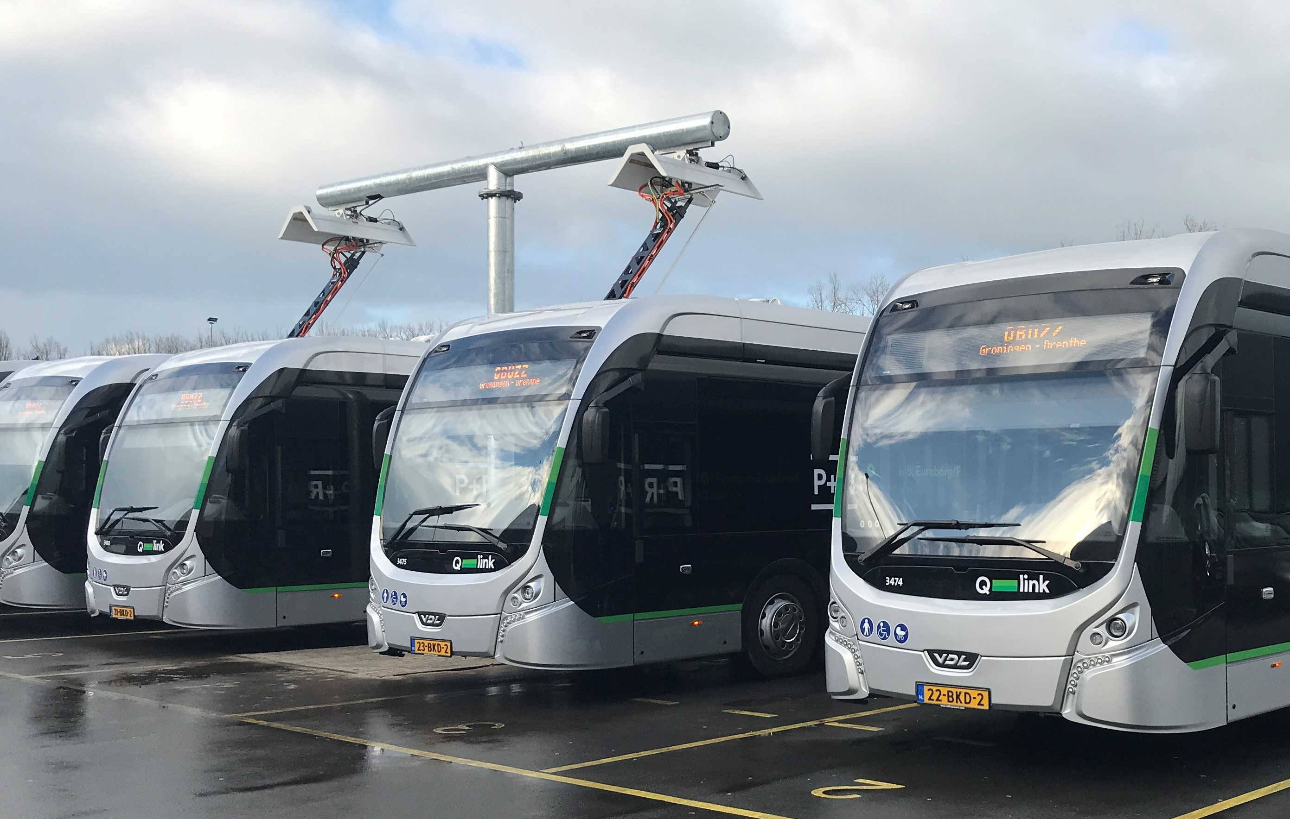

Slide 9
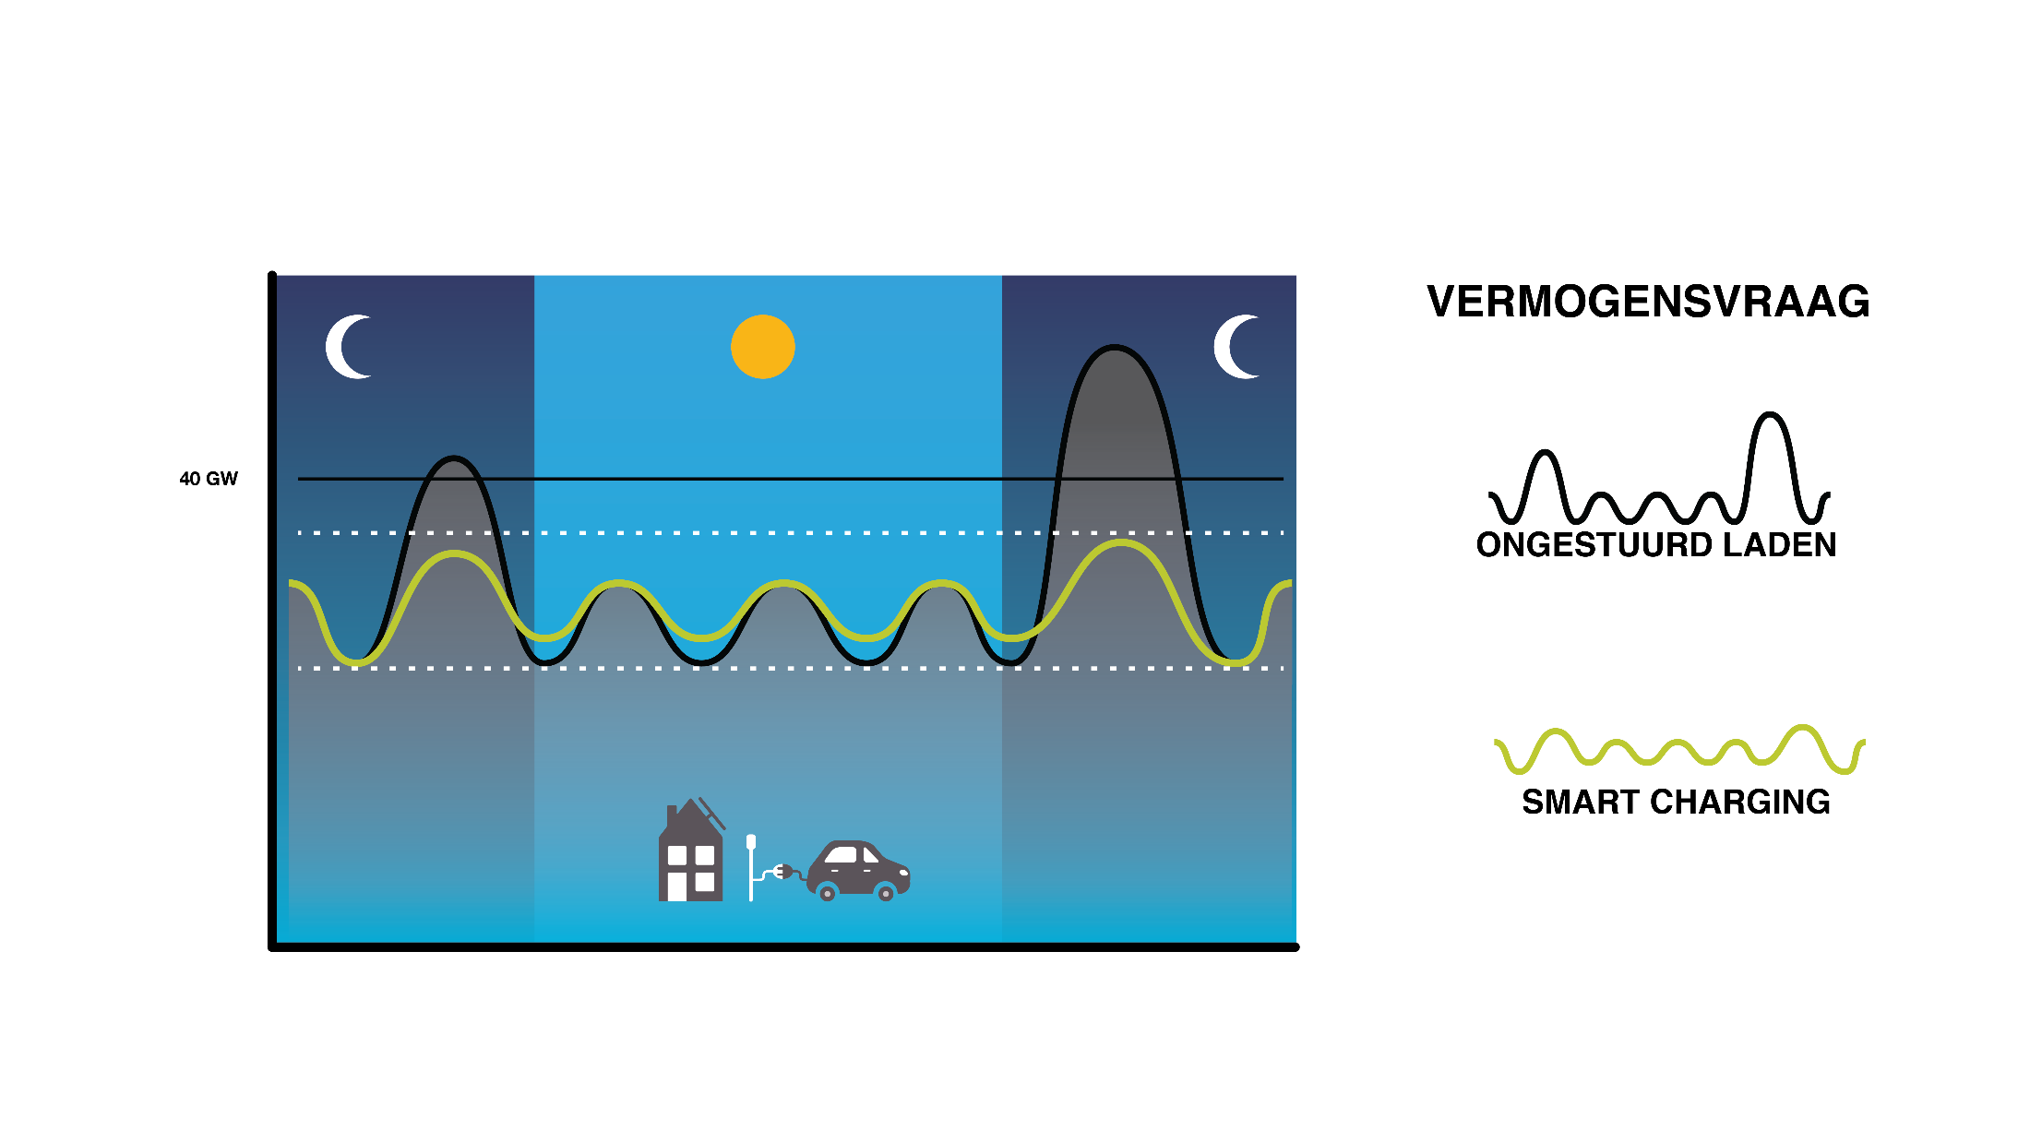
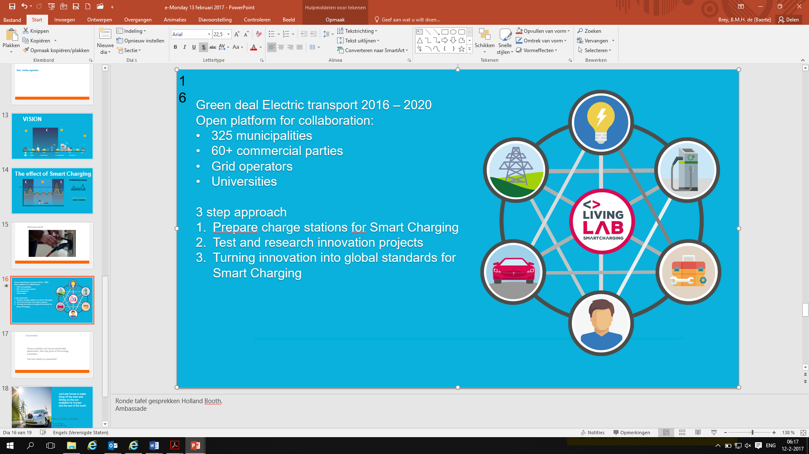
The effect of Smart Charging
Unbalanced grid

Slide 10
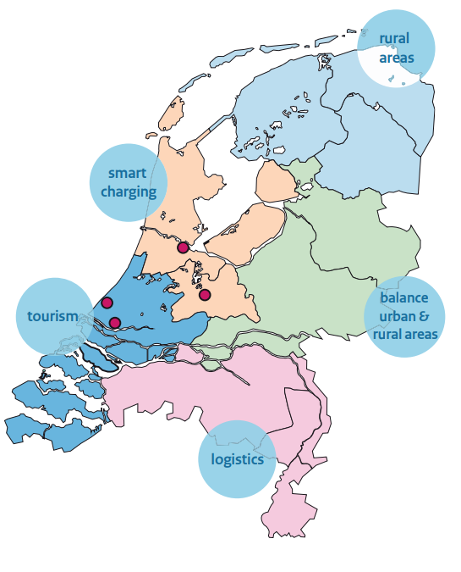
Regional approach
A major part of the actions in the Agenda are coordinated and carried out by regional project offices. In addition to the general tasks, the six regional project offices (5 regions and the 4 biggest cities) have specific accents in their approach.

Slide 11
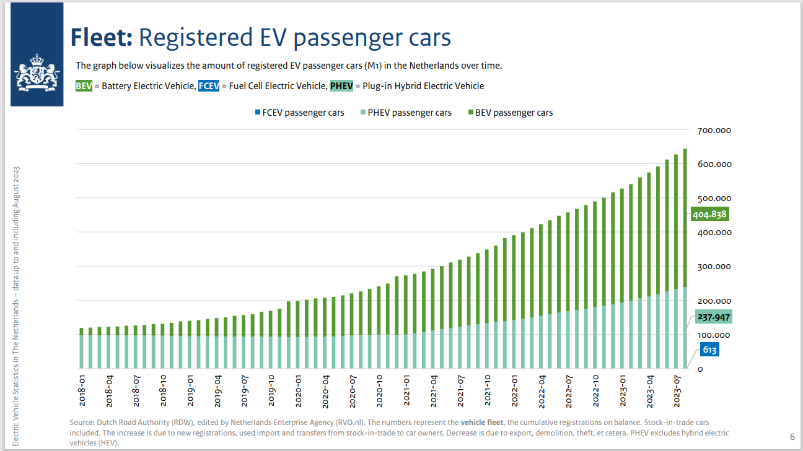

Slide 12
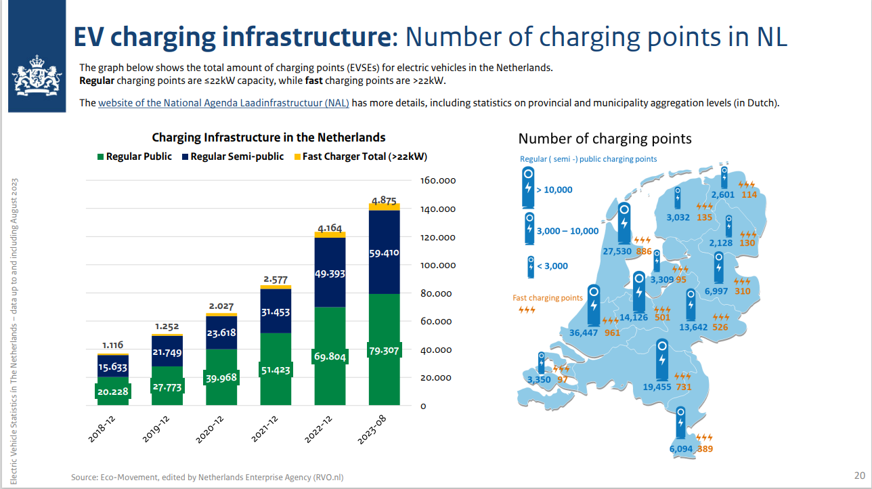

Slide 13
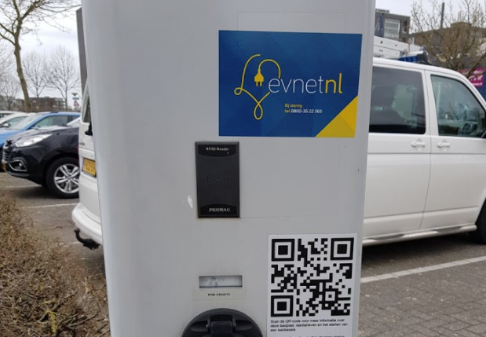

Slide 15
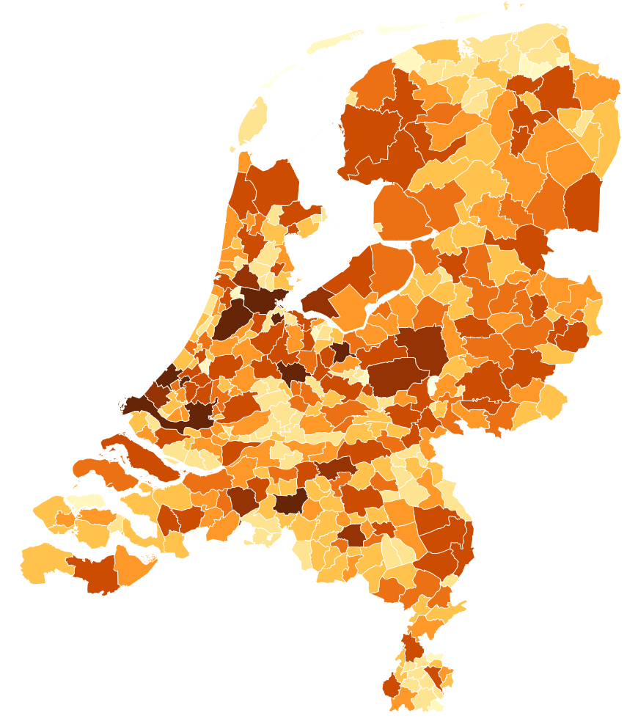
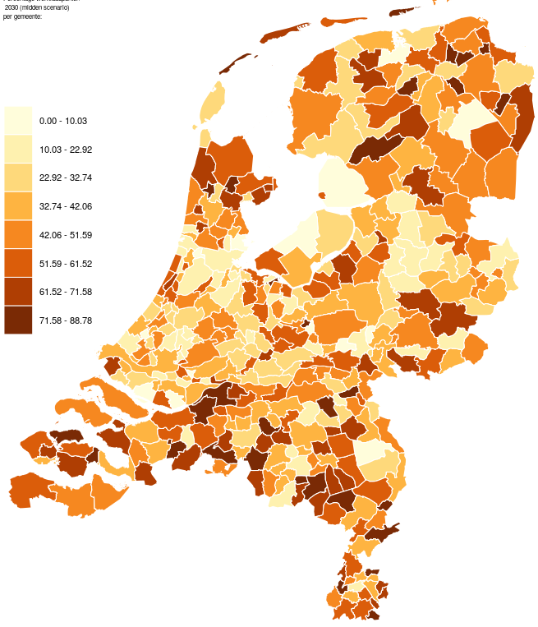
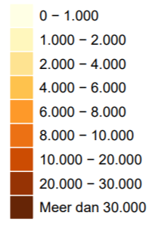
Innovative solutions
Data analytics
Number of EV’s (mid scenario) per municipality in 2035
Percentage of home chargers per municipality in 2035

Slide 16


Slide 17
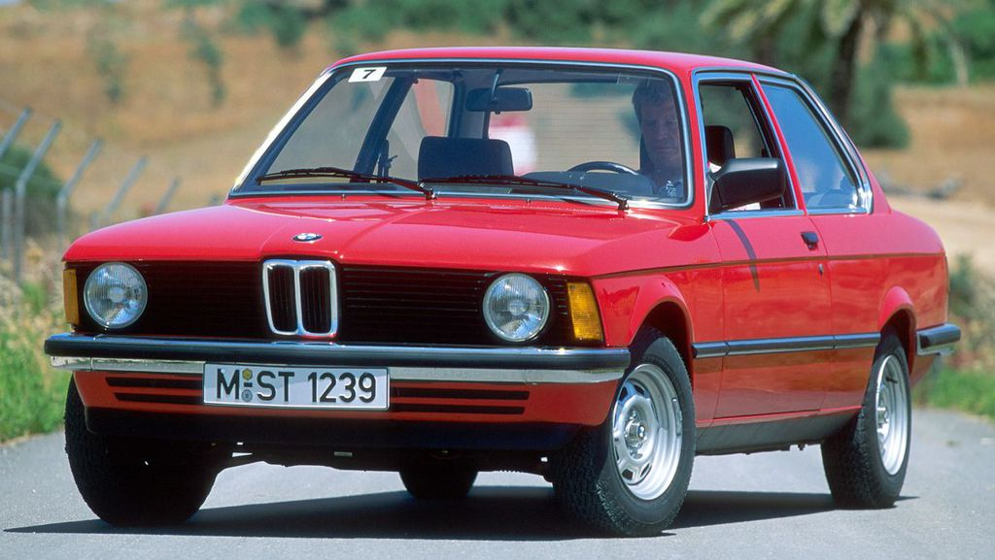
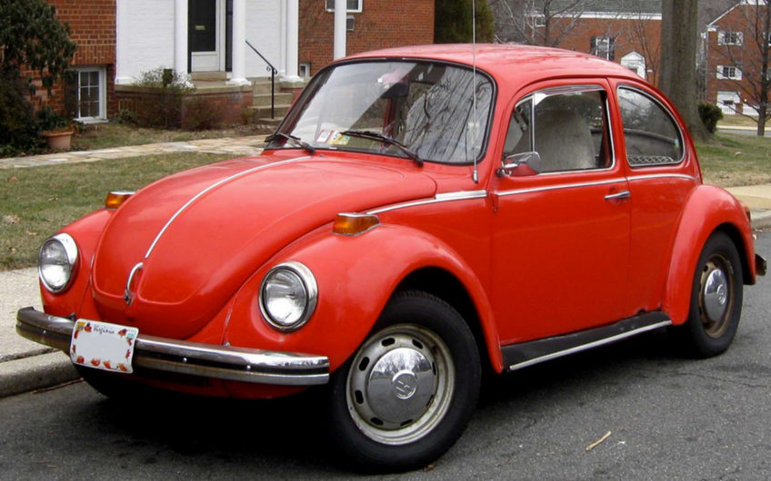
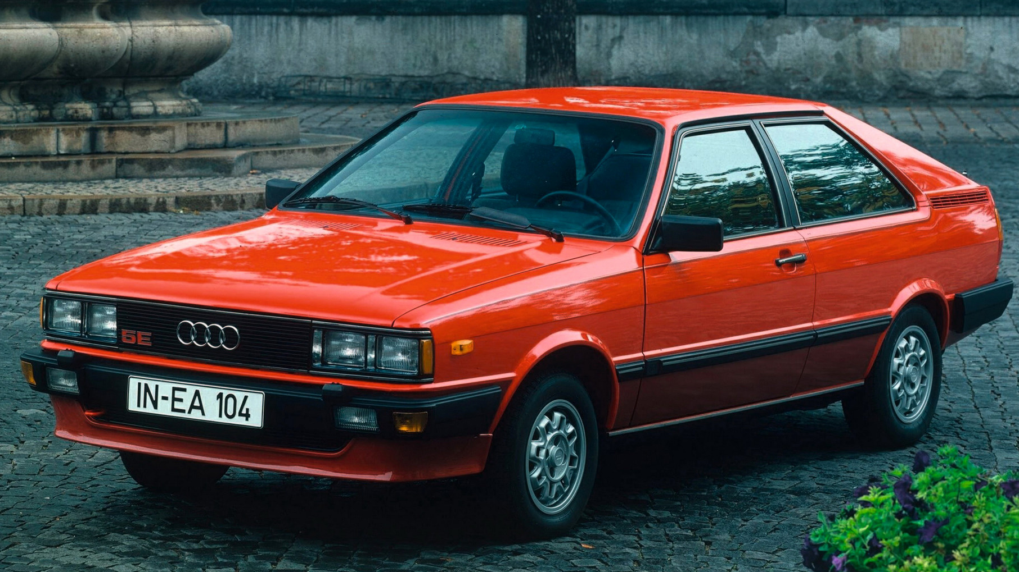
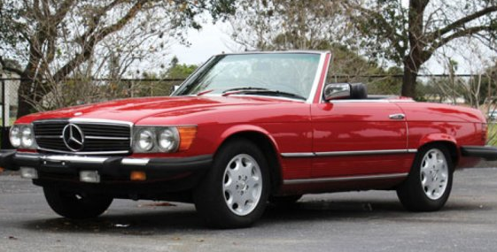
Standardisatie
17

Slide 19
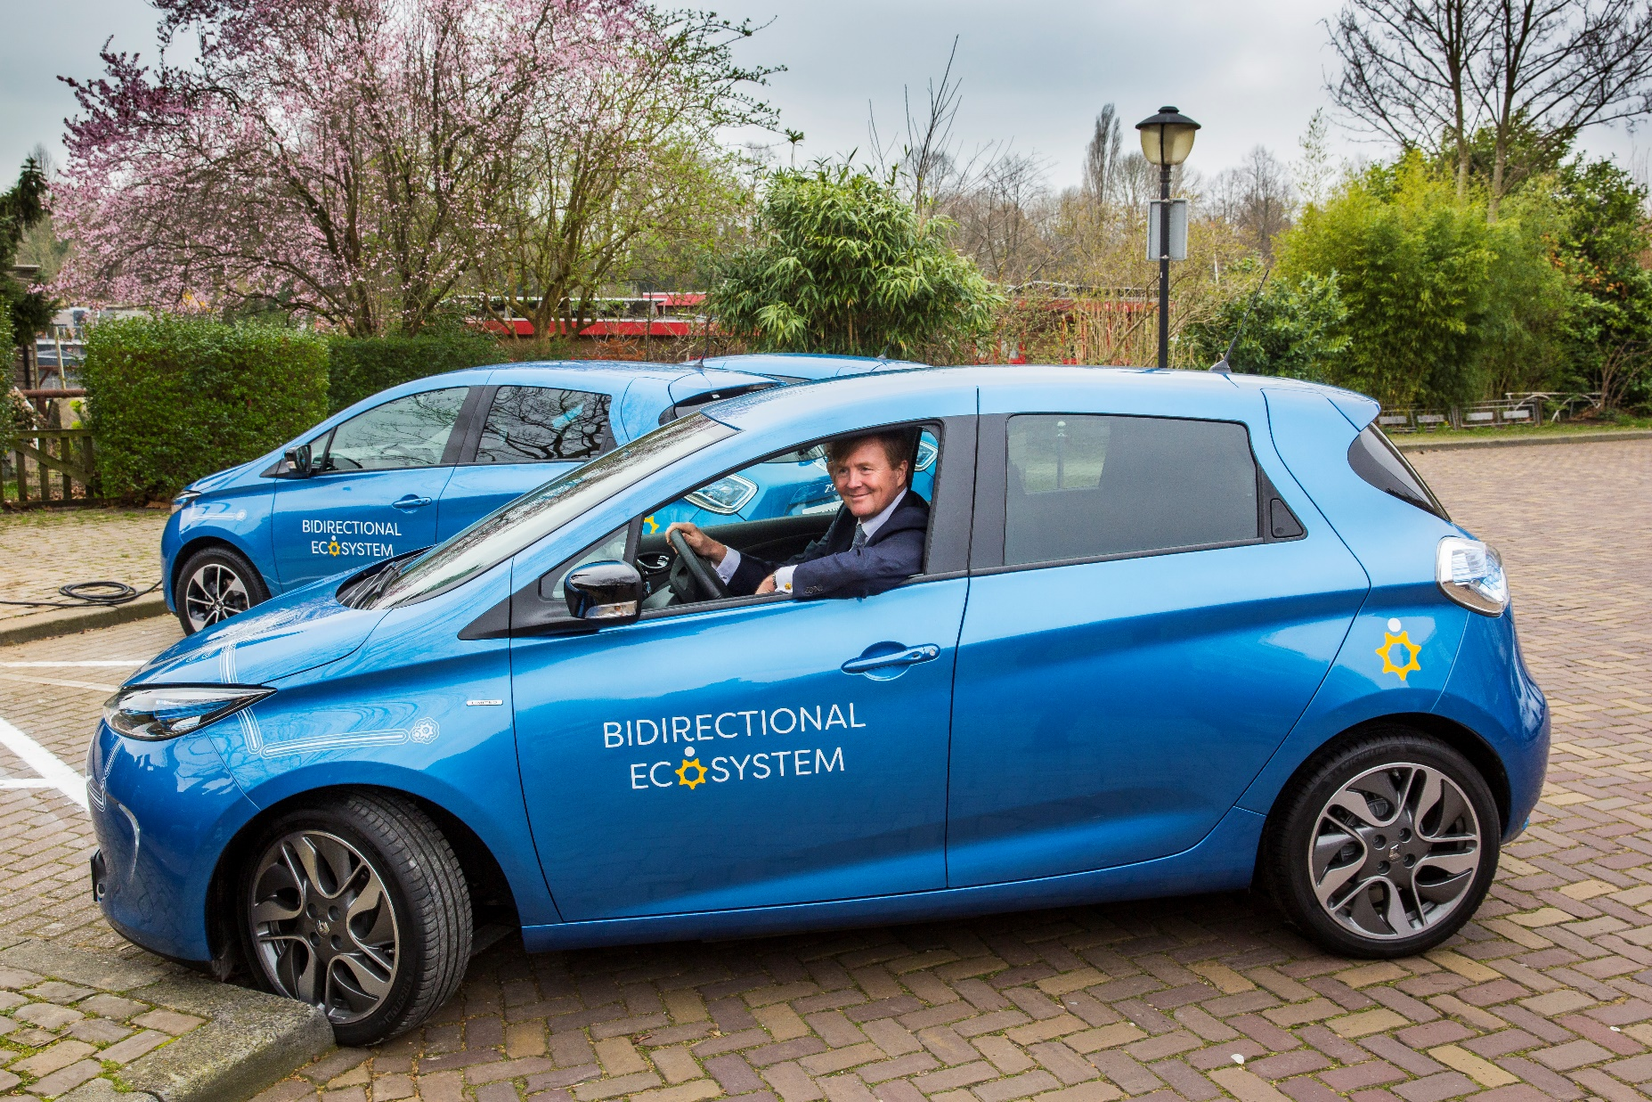

Slide 20
Thanks! baerte.de.brey@elaad.nl

